Slide 1




4
6
POLYNOMIAL CALCULATOR
In C#
2
0
1
3
Mutayyab Imran https://github.com/mutayyab01 From BSE-2B
From BSE-2B
8
7
9

Slide 2
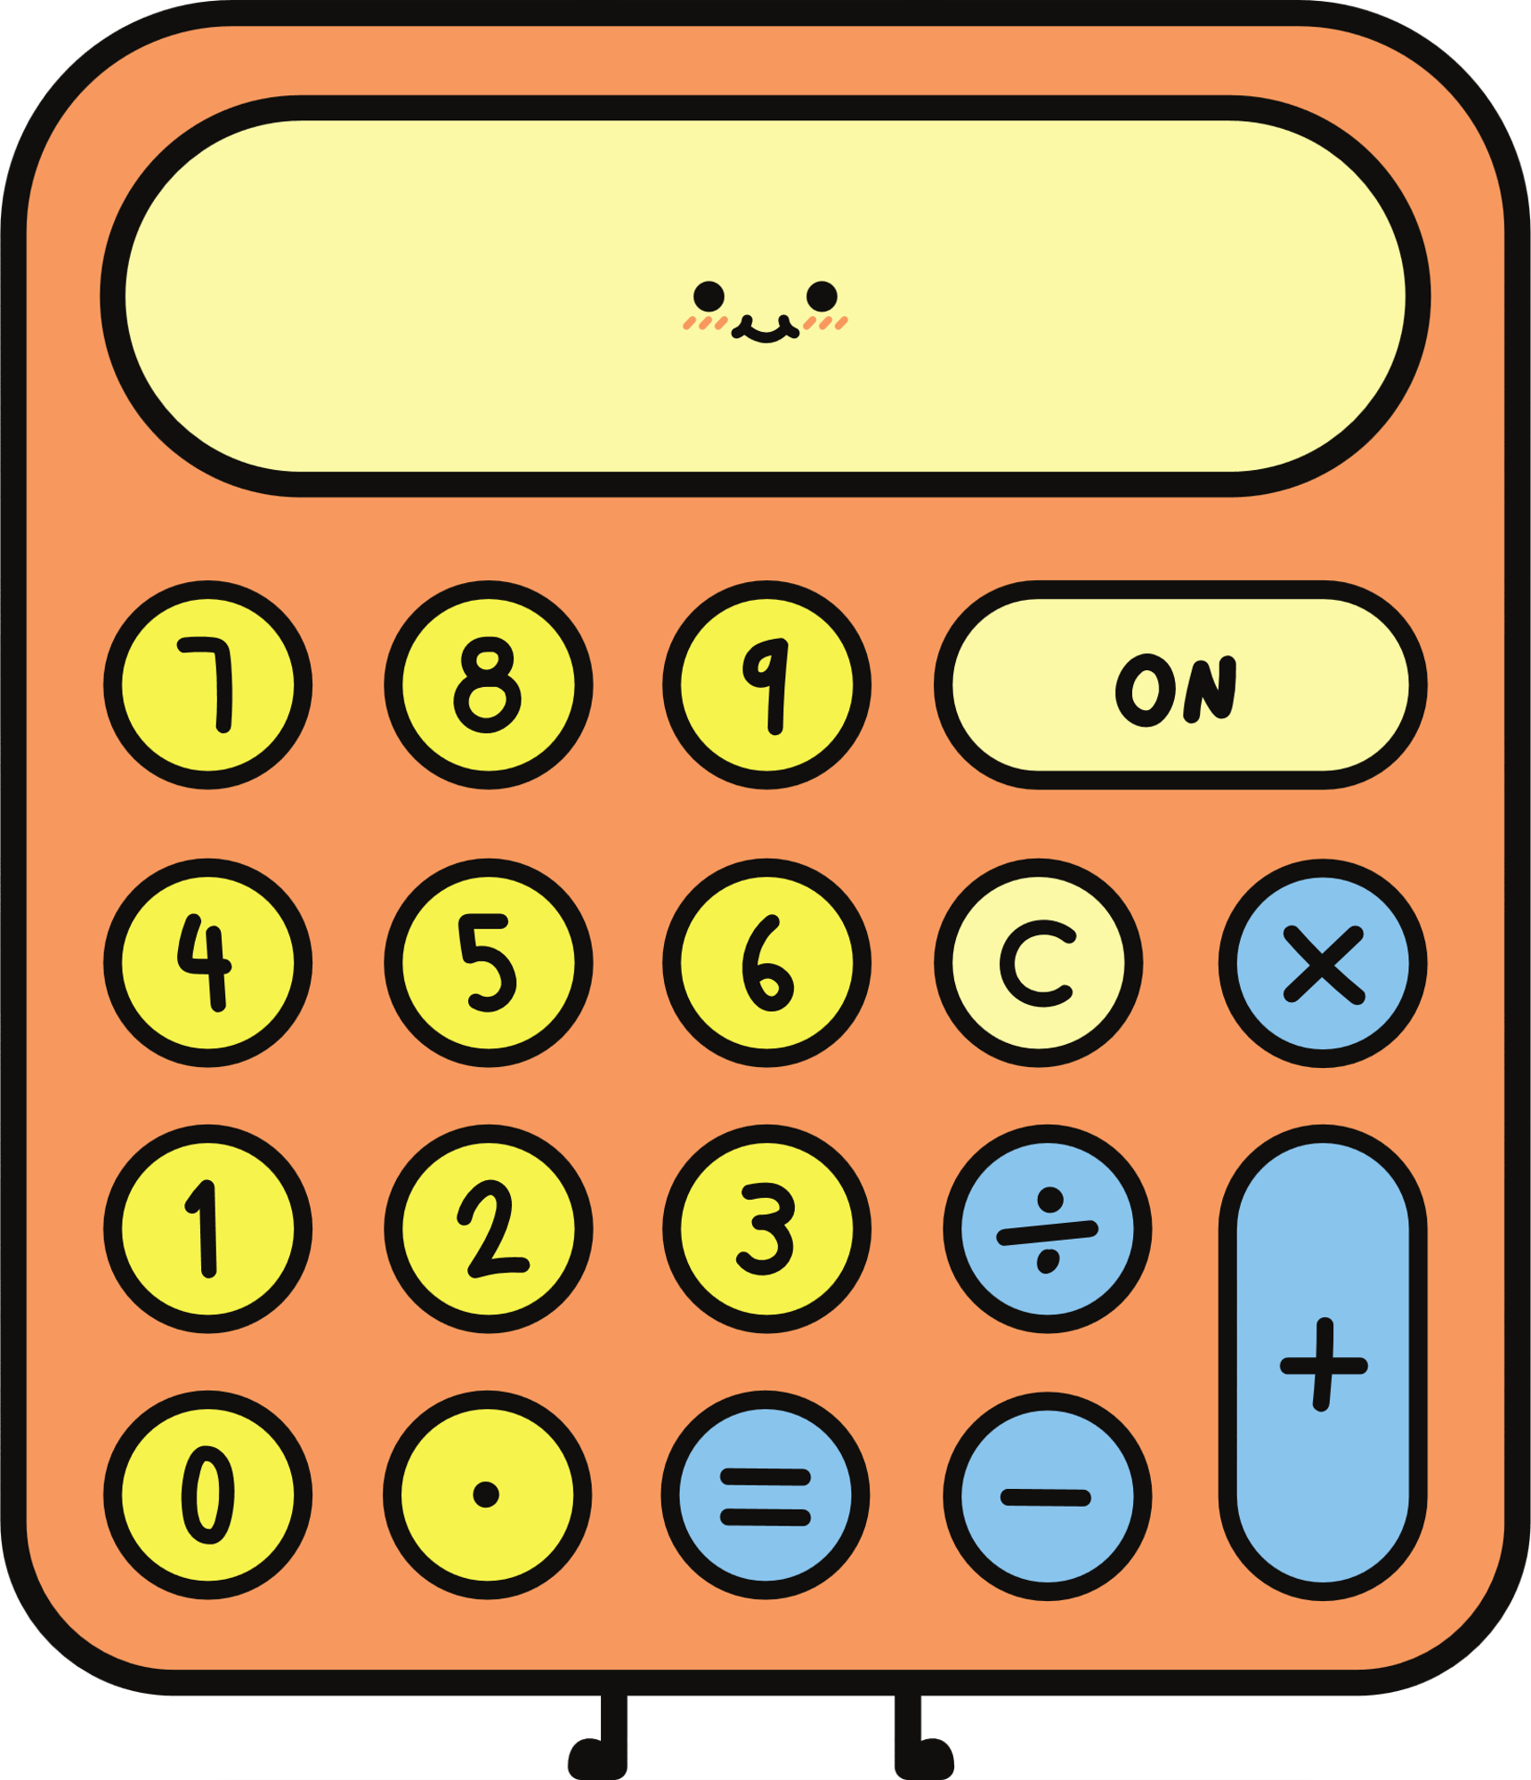

Polynomial
Many terms
Polynomial
many
Type of Polynomial
There are many types of polynomial but here we will discus upto trinomial.
Monomial
Binomial
Trinomial
Nth Polynomial

Slide 3
0
5
Type of Polynomial
6
1
Monomial
A monomial is an expression which contains only one term. For an expression to be a monomial, the single term should be a non-zero term
2
7
Example:
5x
3
6a4
-3xy
3
8
4
9

Slide 4
0
5
Type of Polynomial
Binomial
6
1
A binomial is a polynomial expression which contains exactly two terms. A binomial can be considered as a sum or difference between two or more monomials
2
7
Example:
– 5x+3
6x4 + 17x
2x3+3x2
8
3
4
9

Slide 5
0
5
Type of Polynomial
Trinomial
6
1
A trinomial is an expression which is composed of exactly three terms
2
7
Example:
– 8x4+2x+7
4x2 + 9x + 7
4x3+3x2+2x
3
8
4
9

Slide 6
Polynomial
A Polynomial is an expression which is composed of more than three terms.
Example :
5x4+4x3+3x2+2x+1
10x3-x2-5x+11

Slide 7
0
5
FUNCTIONALITIOES:
6
1
Add Polynomial
Subtract Polynomial
Multiply Polynomial
Find Value Of “X” In Polynomial
Check Both Polynomial Are Equal Or Not
2
7
3
8
4
9

Slide 8
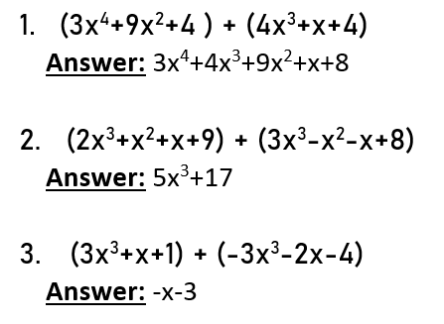
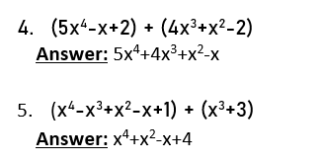
ADD POLYNOMIAL

Slide 9
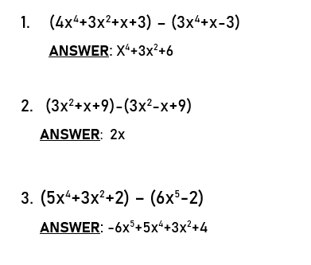
SUBTRACT POLYNOMIAL

Slide 10
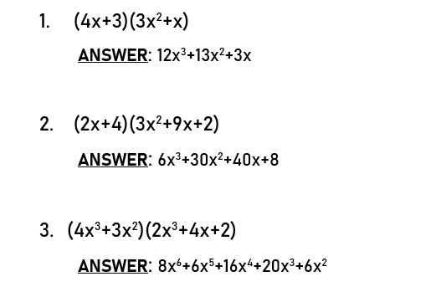
MULTIPLY POLYNOMIAL

Slide 11

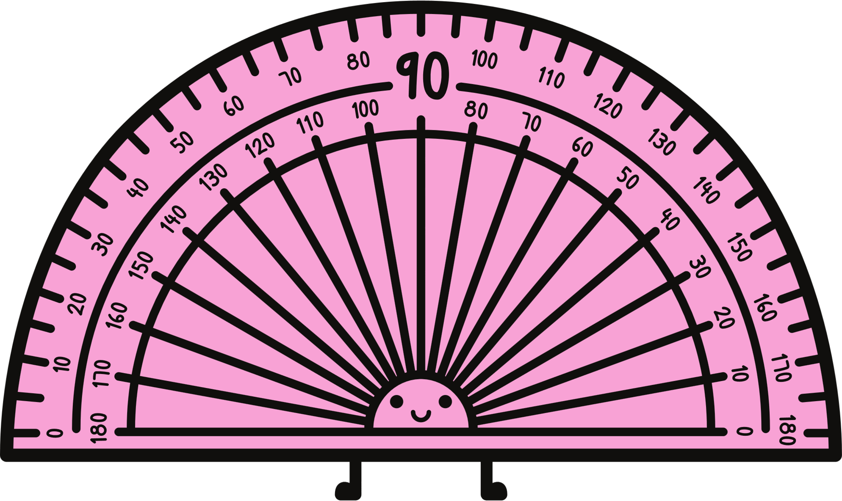

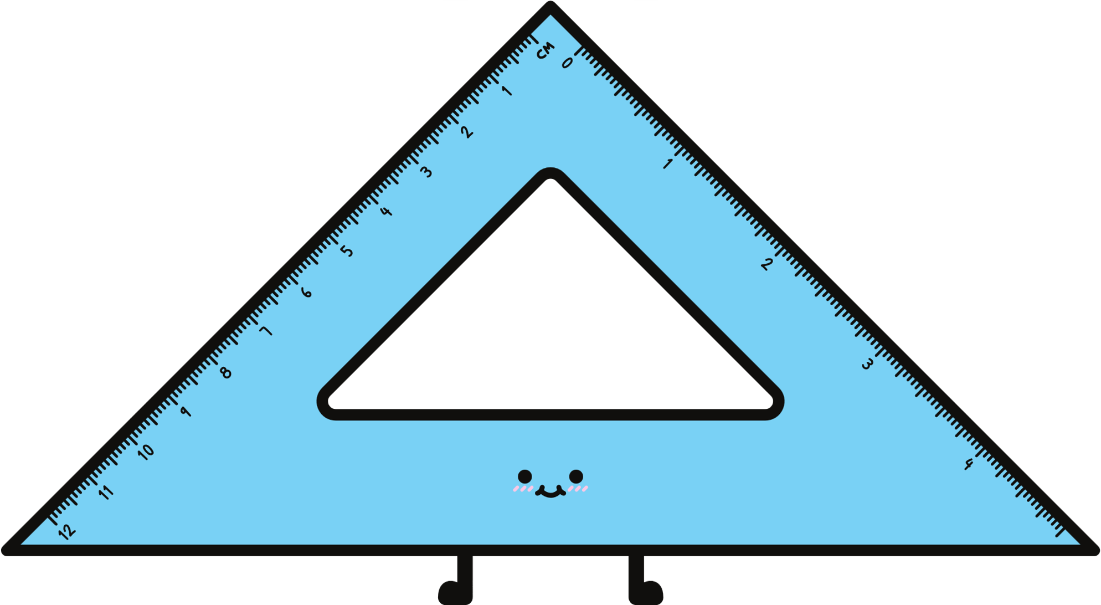

THANK YOU

